Slide 1

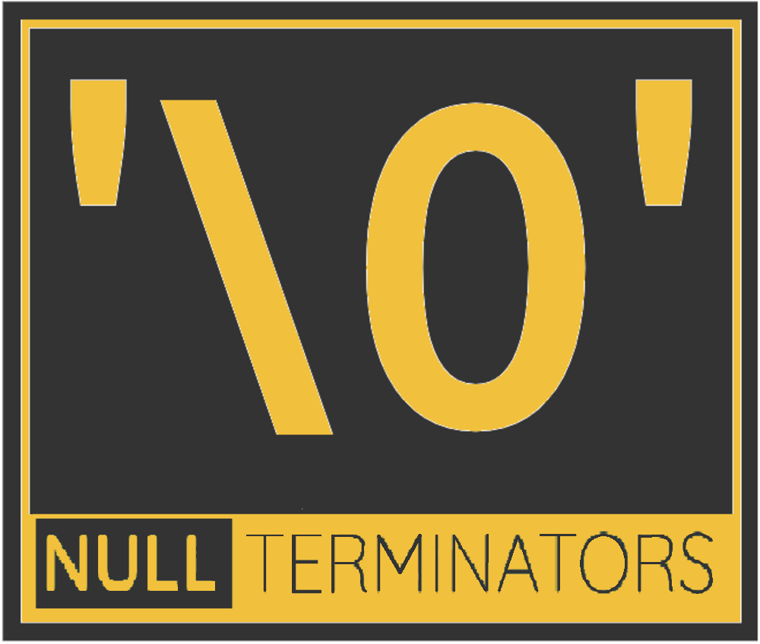
Automated Toolbox Inventory Control System [ATICS]​
Sponsor: Hiline Engineering​
Mentor: Dr. Neil Corrigan
Team Members:
Reem Osman, Project Manager
Caitlyn Powers
Caleb Thomas Navin Sabandith Steven Pixler
Notes:
- Talk about the testing part - Project scope and requirements set by us - Talk about results - Requirements for best performance - Show video

Slide 2
Background
Sponsor has many buildings, each containing several toolboxes
Employees occasionally forget to return tools after use, leading to:
Disrupted workflows
Delayed projects
Increased operational costs
Auditing toolbox inventory is expensive and time consuming
What if auditing process could be automated…

Slide 3
Solution
Develop a computer program implementing the following model:
- Toolbox unlocked via RFID badge; triggers inventory audit
- Process video camera footage to identify missing tools
- Assign tools as checked out to employee
- Log tool checkouts in database

Slide 4
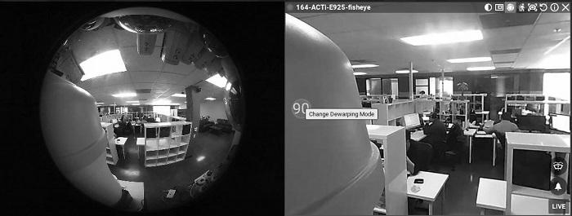
Initial Assumptions
A Camera
No warping (fisheye lens)
No automatic Zoom
Streams over RTSP
A ToolBox
Each Drawer
Unique identifying symbols on each drawer
Tools arranged in shadow box
Each Tool
Has Unique symbol
Assigned a single location in the drawer

Slide 5
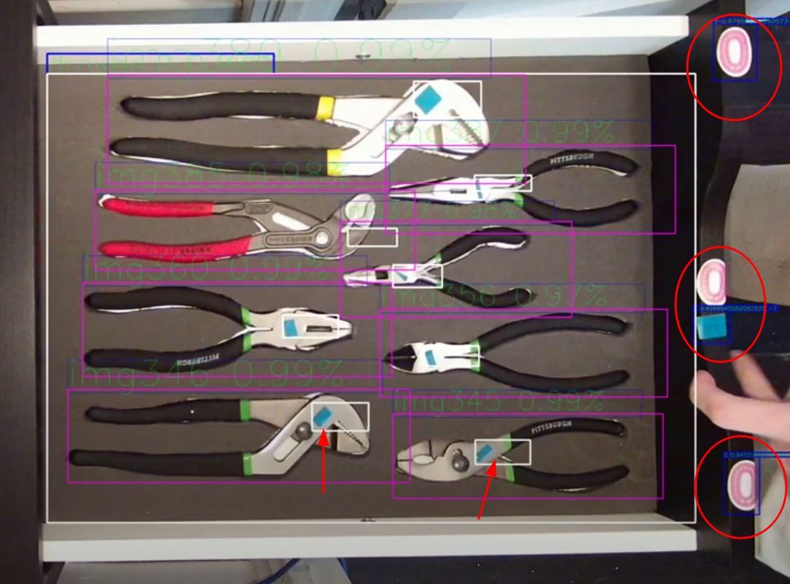
Example Drawer and Tools

Slide 6
ATICS Components
Computer Vision:
Template Matching
Classifier
Backend Infrastructure :
API
Database
File Server

Slide 7
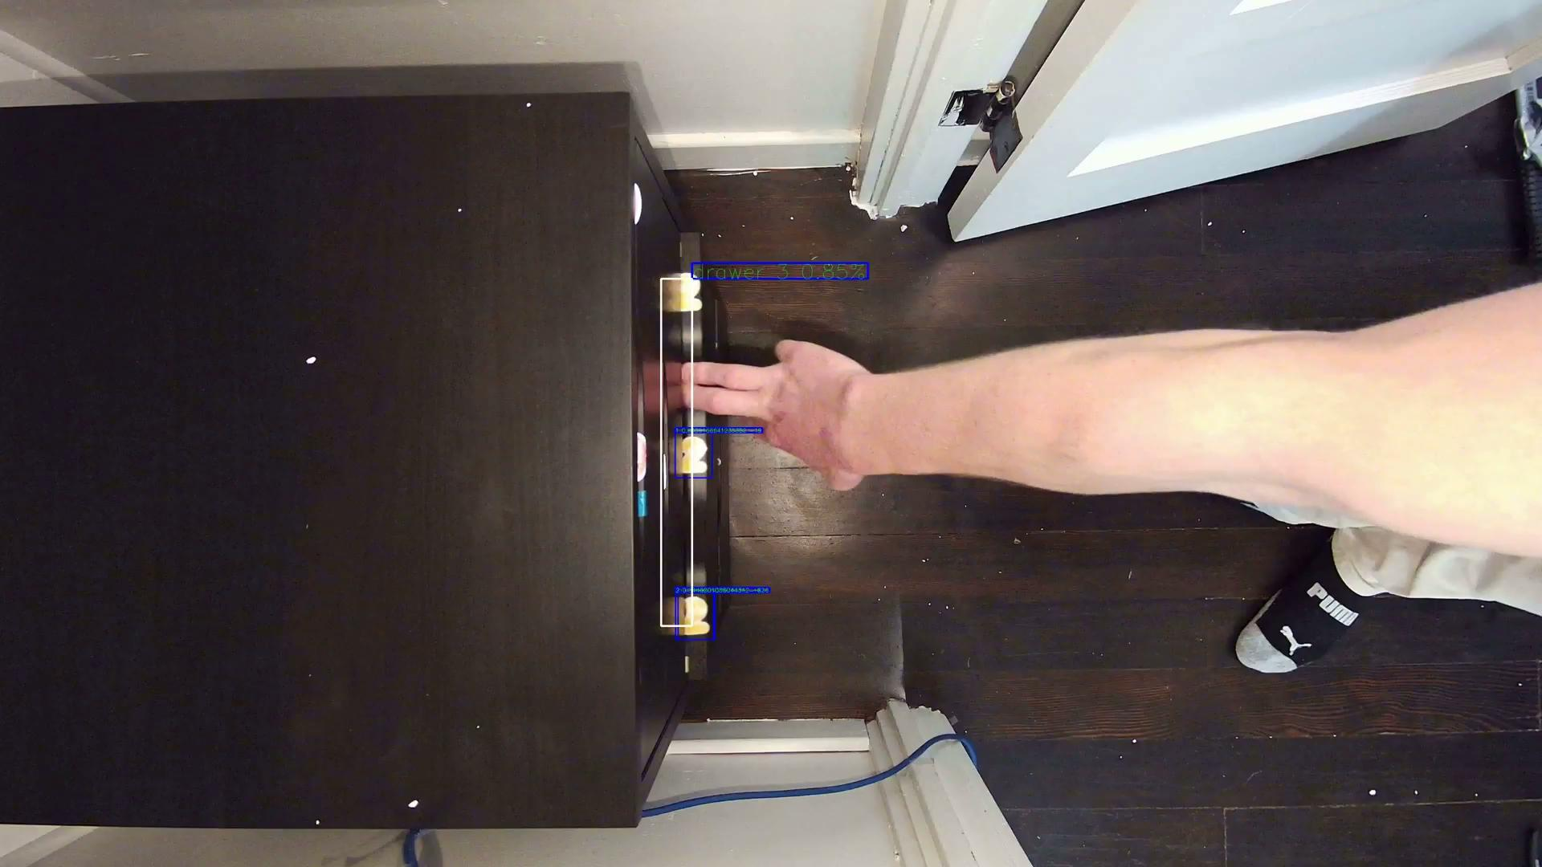
Computer Vision - Frame processing
Find drawer using drawer symbols
Locate tools and determine their status
Look for extra tools in the drawer

Slide 8
Computer Vision - Template Matching
Template matching - A technique to match areas of an image to a template image.
Takes 2 inputs:
Image in which an item is being searched for
Picture of the item to use as a template
Inputs are used to compare the template picture to the image, moving the template one pixel at a time.
After each move, a metric is calculated to show how similar the template is to that particular area of the picture.
Notes:
https://docs.opencv.org/4.x/de/da9/tutorial_template_matching.html
Their are a few different metrics that can be used with one example being the sum of squares.

Slide 9
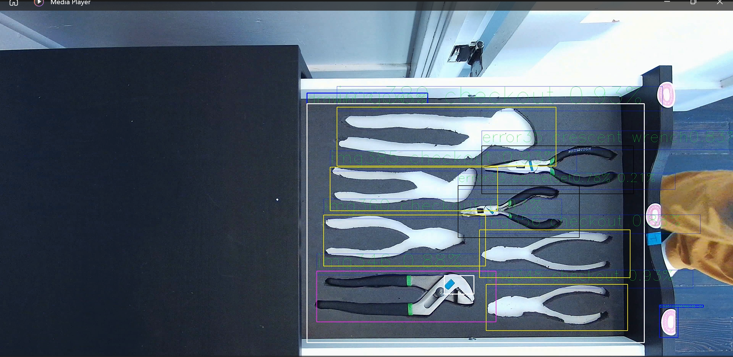
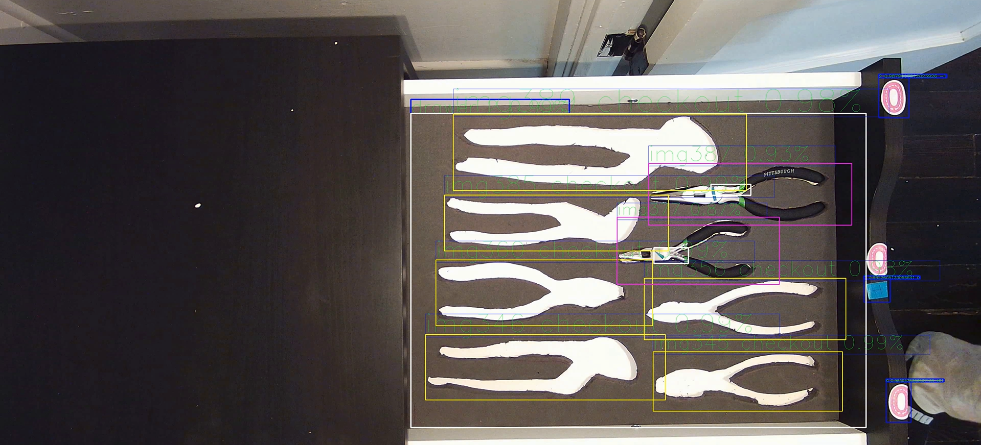
Template Matching - Challenges
Technology has difficulties with differences in:
Lighting
Rotation
Size
Notes:
But that’s not to say you can’t implement things around it or that it can’t deal with them at all, as seen by how in the pictures even through the lighting conditions are different it can still tell that that the tool is their or not their just with a lower result metric. The two errors whitch are denoted with black boxes in the first picture actually come from the next part we are going to talk about which is neural networks.

Slide 10
Computer Vision - Classifier and Deep Neural Network
Image Classifier- A trained neural network designed to use PyTorch to use the computer to label images as a predetermined class.
Training involves exposing the model to a dataset containing annotated images.
Through iterative optimization, classifier learns to recognize patterns corresponding to the specified tools.
The learned patterns are then exported as an ONNX configuration file to be used by the template matching portion of the program.

Slide 11

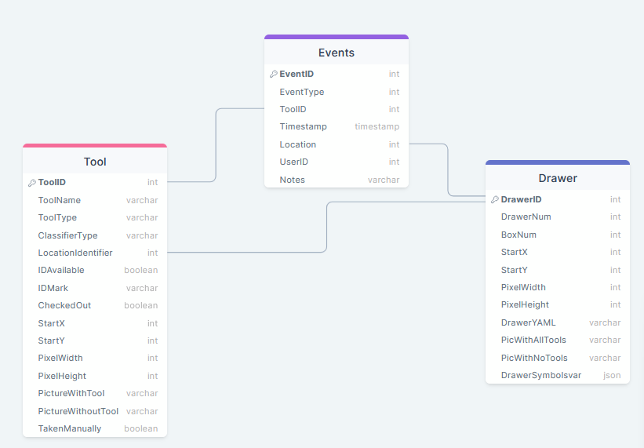
Backend Infrastructure
Database:
MySQL server 8.0
Stores information about tool boxes and drawers
Records tool location and checkout status
Records check in, check out, and error events
Schema
3 Tables
Tools, Events, and Drawers

Slide 12

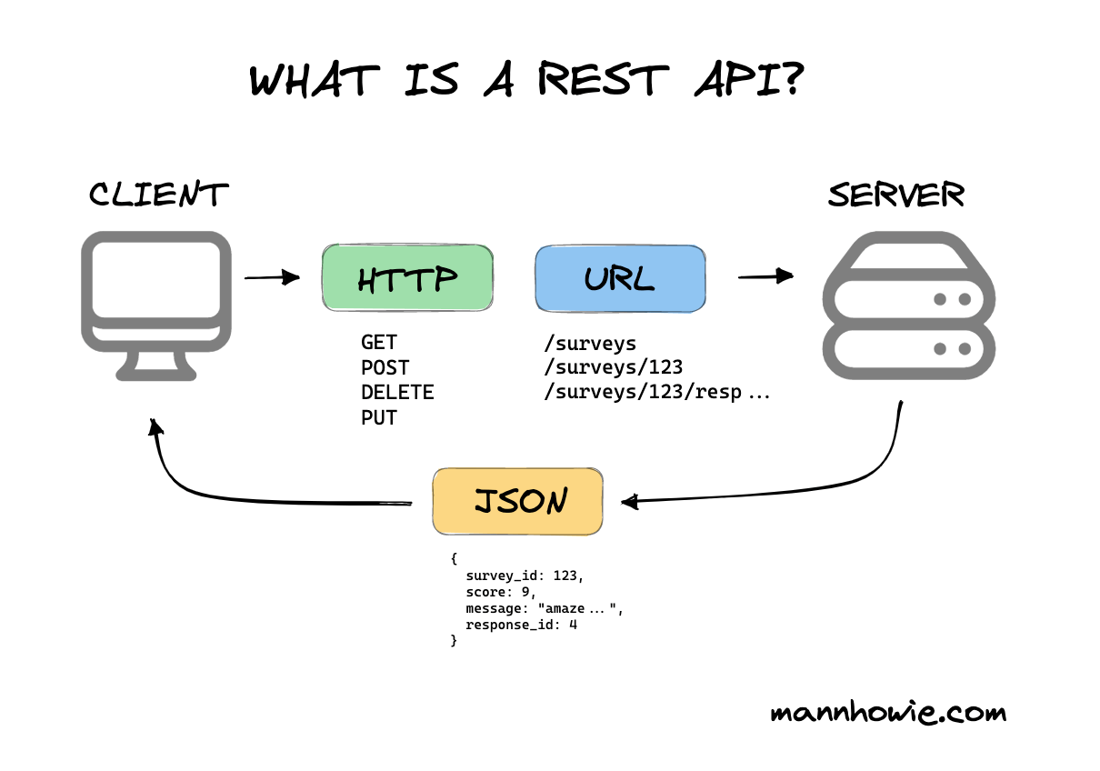
Backend Infrastructure
API:
Written with Flask and Python
provides communication between the computer vision component and the SQL server.
Queries are issued by custom python functions that send HTTP ‘GET’ and ‘POST’ requests to different API endpoints.

Slide 13

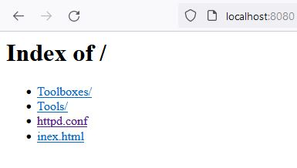
Backend Infrastructure
File Server:
Web server which holds image and configuration data for drawers and tools
Apache server chosen - best at natively serving a directory
Single, central server can be accessed by multiple toolboxes simultaneously
Eliminates the need to duplicate data across every toolbox

Slide 14

Backend Infrastructure
Architecture:
Collection of microservices run on Docker
Single command to start entire backend
Docker compose up
Multiplatform - works on both Windows and Linux hosts
Single physical server can host all services

Slide 15
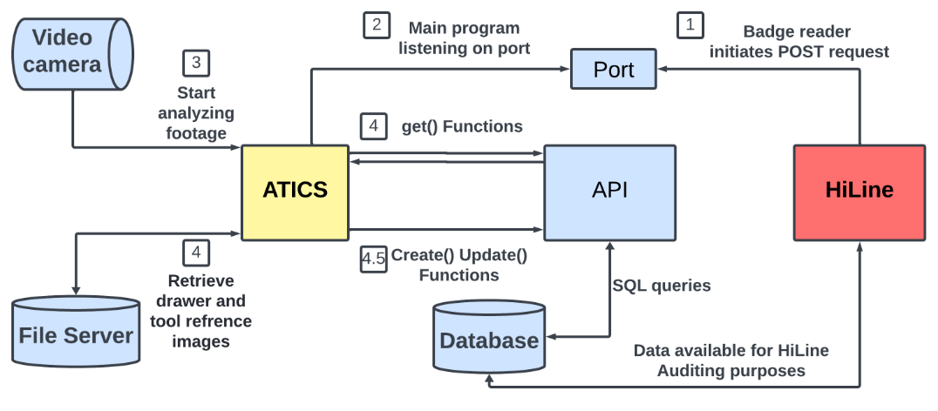
Backend Flow Chart

Slide 16
Result
Program creates:
Bounding Box around tool and drawer displaying:
Name from the database​
Status (Tool: checked out, checked in, or error)​
Confidence percentage
Output to the Database
Accuracy: 84%
Notes:
65.2% in an unstable set up Overall accuracy 143/170 = 84%. Drawer 1 which is made up of pliers is 22/24 = 91%. Drawer 2 which is made mallets and wrenches is 16/24 =66%. It should also be noted on drawer 2 that no templates were recropped so some of the templates showed parts of other tools in them. Drawer 3 was mostly sockets and it has an accuracy of 77/90 = 85%. It should be noted however that in the debugging video the sockets did appear to be error a lot of the time even if that was not the case in the last frame that it though the drawer was open and saw the certain socket. Drawer 4 was mostly crescent wrenches and have a accuracy of 28/32=87%. It should be noted that the wrenches were error a lot of the time in the video even if that was not the case in the last frame it though it was open. Their were also only 3 cases of a wrong tool being placed in this entire set of testing.

Slide 17
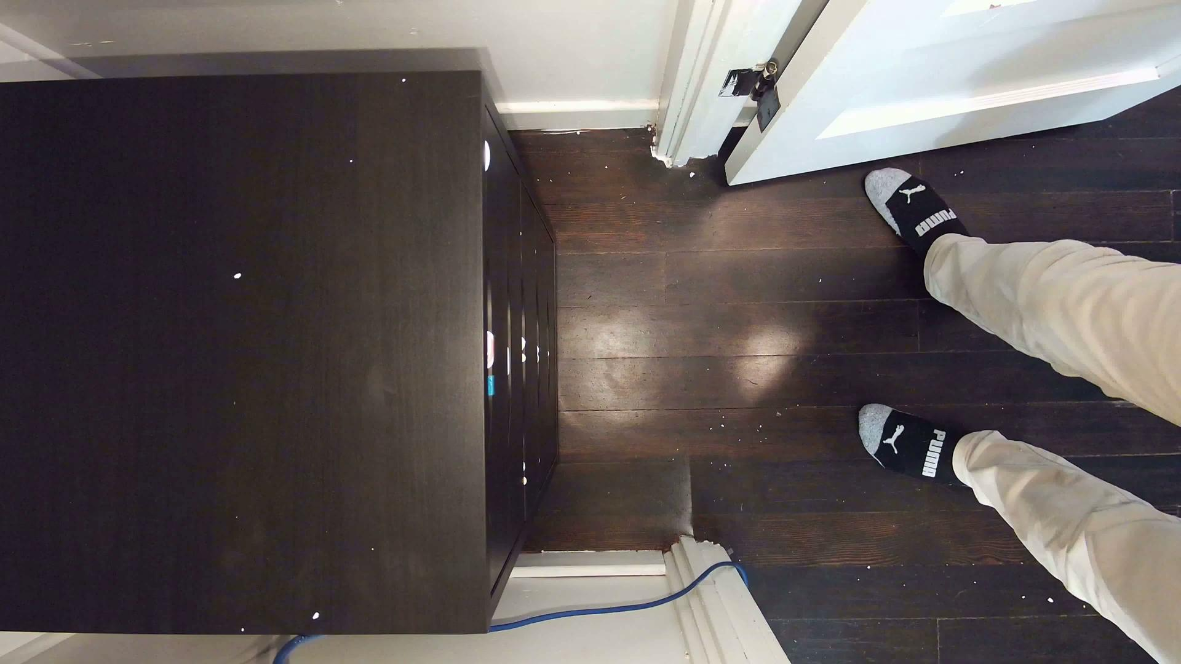
Result - Video

Slide 18
Challenges
During the project, several challenges were encountered
Speed of execution
Blurring when opening and closing the drawer
caused by the framerate not being high enough
Small objects like sockets
difficult for computer vision to distinguish.
Notes:
For 5 tools in a drawer 5 second per frame, 10 frames per second video -> 37 (370) seconds video takes 18 minutes
The speed can be improved by multi-threading the program, and hardware acceleration. Small objects like sockets have two issues the first is because of how close together they can be put it can be difficult to read the text in the video telling you information like the similarity metric, what tool its being classified as, etc and the 2nd is that because its smaller it is more sensitive to changes like light, or being placed slightly off.

Slide 19
Future Work
Increase speed
Multithread the program
Use specialized hardware to improve speed.
Restrict small objects like sockets to the drawer closest to the camera.
Notes:
Mulithread to : -Get footage
-process Frames
- Multithread for - Drawer open
- Tool status
- Extra tools
When Multithreading is given you can Increase FrameRate, of the camera, so that blur is not as much of a problem.
By having smaller objects in the drawer closest to the camera you are increasing their pixel size

Slide 20
Questions?

Slide 21
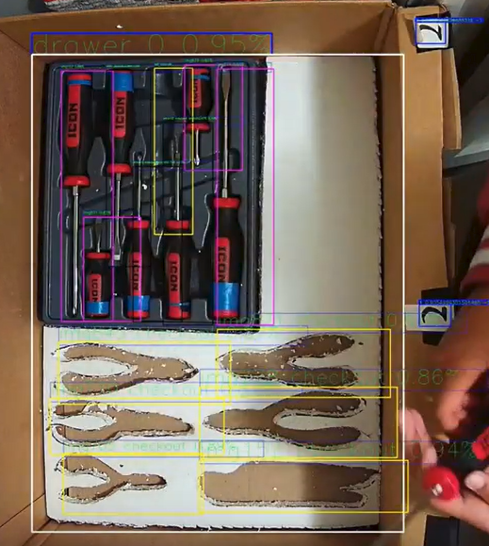
Initial testing setup

Slide 22
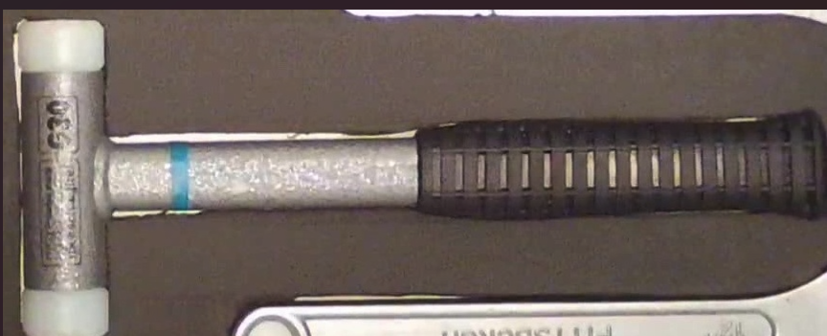
Example of a good template vs a bad template

